Slide 1
Study on Task Management System

Slide 2
Domain: Algorithms
Scope/Aim : To provide a solution to the people who have a lot of extra curricular activities to do for developing self, but find it difficult to arrange the activities in their busy schedule.
Keywords: Task timetable generation, Diet plan generation, Prioritization of tasks, Eisenhower’s decision matrix(task matrix).

Slide 3
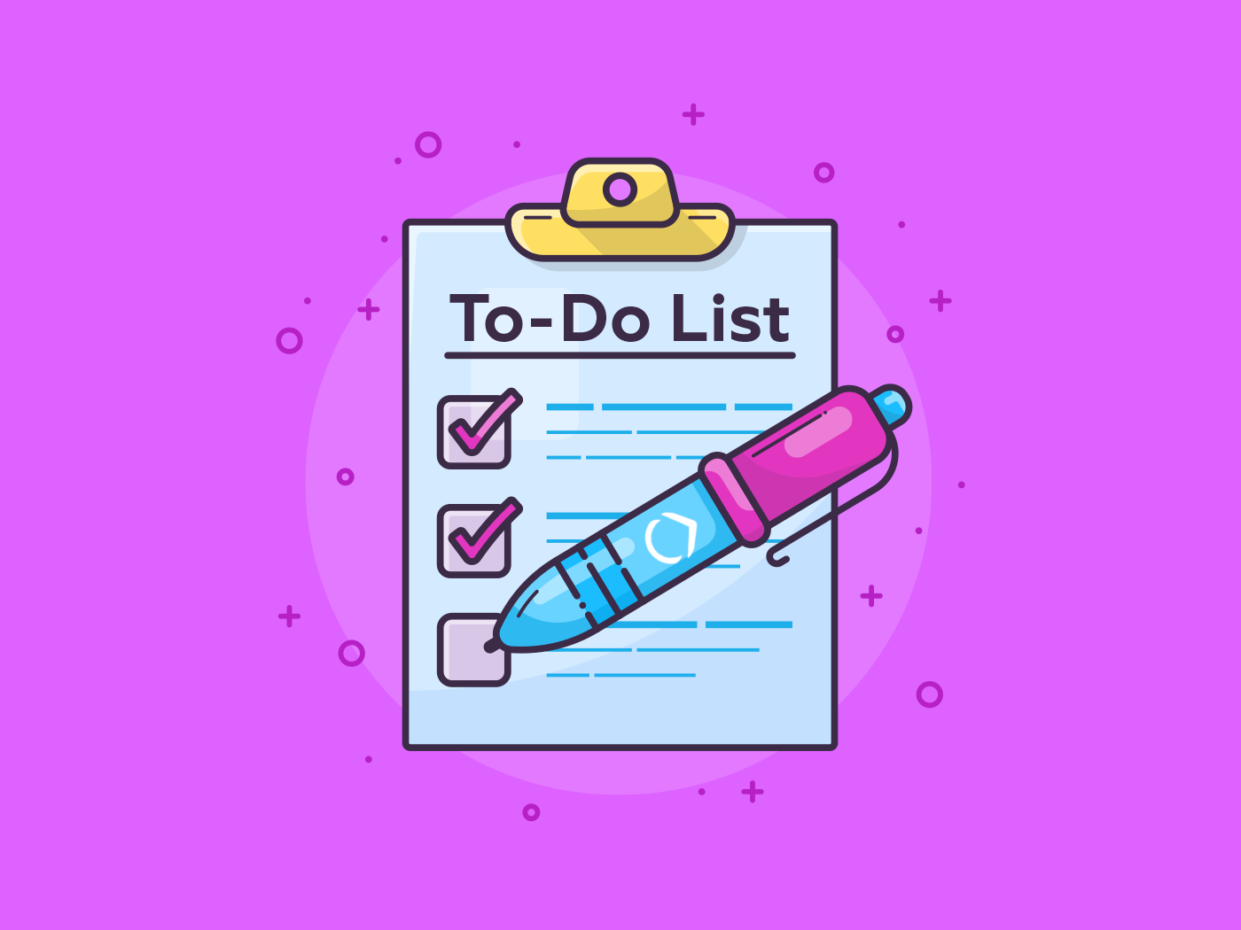

1.INTRODUCTION:
We are undoubtedly aware about the workload people come across in their day-to-day routine.
Further, leading to overlook their health conditions. By making a list of tasks to be performed and prioritizing as per ones needs, tasks can be performed efficiently. This will save the time and can lead to betterment of user’s health.
There exist various kinds of manager which take input data and act as a reminder, but neither of them helps in scheduling the tasks. Healthy Task manager provides the solution to these tasks.
It will use Eisenhower decision matrix to prioritize the user’s tasks.
Objective of the Healthy Task Manager is to generate two things:
Task Timetable
Diet Timetable.

Slide 4
2. LITERATURE SURVEY:
Additional curricular activities are something that separates anyone from others and builds up one's identity of having a wide range of abilities. But, one often gets in a dilemma as to how these activities can be arranged in the stressful pre-defined schedule. Thus, one loses interest in carrying out the extra activities. This manager helps in solving this problem.
Prioritizing the Tasks
User must know the objective as to allocate time for each tasks
Implementing fixed time
Scaling as per their comfort
Stress and relief scale from -10 to 10
Maintaining their diet
Achieve healthy living

Slide 5
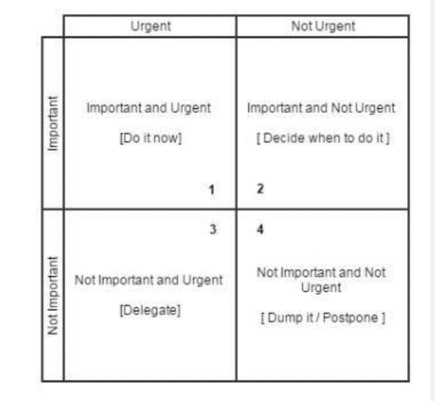
Task Matrix Working:
Provides solutions for prioritizing the tasks.
Fitting task in specific amount of time.
If task cannot be completed, it can be removed or the allotted time needs to be reduced.
This 2x2 matrix will arrange the tasks according to urgency and stress or relief levels .

Slide 6
Advantage of Task Matrix:
Prioritize the tasks in case if they do not fit in the allotted time.
Least important task will be in in 4th quadrant and can be removed without hesitation.
Working of Healthy Task Manager:
UI will provide login and register page.
Two options will be provided:-
Task Manager which will generate an efficient task schedule
Health Manager which will generate diet plans.
Schedule will be generated as per weekly OR daily goals as required by the user.

Slide 7
TASK MANAGER FEATURES:
The user can create schedules.
The algorithm will take unbiased decisions and allot the time slots for the tasks such that (Stress + Relief) in a day approximately becomes 0.
Choice will be given to the user to delete one or more tasks or to reduce the allotted time to any of the tasks.
The unallotted tasks will be mostly from the 2nd,3rd and 4th quadrants, out of which user can delete the tasks within 4th quadrant as these are not much important.
2nd and 3rd quadrants will be sorted as per the prioritization(will contain different factors) and the user can delete the least prioritized task or can reduce the time of the least prioritized task.
Finally, when all the factors are gained, an efficient timetable of tasks will be generated.

Slide 8
HEALTH MANAGER FEATURES:
Provides the drop down list of the food items whose calories are advancely known.
User can sort the food items according to costs or number of calories.
The Diet Generation algorithm where the calculations will be done.
It will be taken care that the user gets a particular “x” number of calories per day or week. Also, it will remind the user as to which meals are remaining to consume and which have been taken, in case the user forgets to do so.

Slide 9
Technology :
Android Studio
MYSQL
Conclusion :
The Task Matrix will have many features. The first and most obvious use of the application is take the current ‘to-do’ list and sort all the activities into the appropriate matrix. Then, assess the amount of time required to accomplish the lists and, if necessary, reallocate activities.
Task Matrix also may be used to decide priorities among possible causes of a performance weakness or problem to address, or to choose the best solution(s) for a given problem. Decisions are based on agreed upon criteria, thus reducing the potential for choices based on hidden agendas.
This application will also have a diet plan generator for maintaining the balance between the workload and health.

Slide 10
THANK YOU

